Slide 1
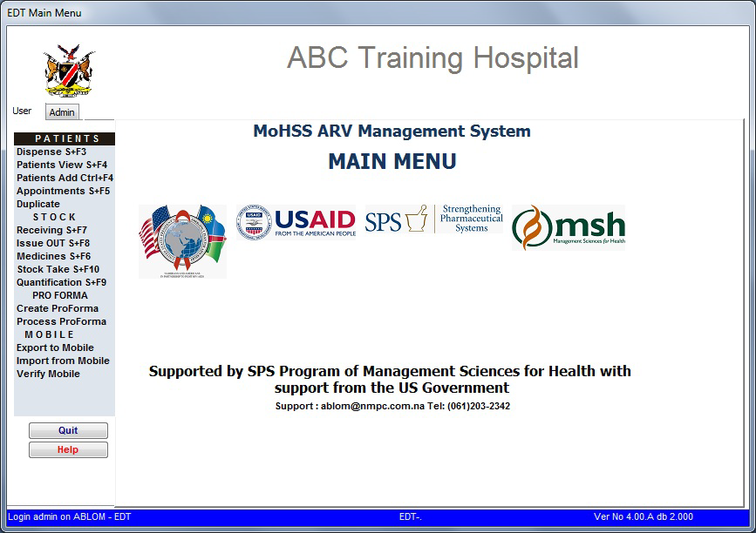
Patient Management at Main Site
The Electronic Dispensing Tool ART Processes

Slide 2
Entering Patients into the System .
New on ART
Required: Patient Care Booklet (PCB)
Use case:
Patients being initiated on ART, including pregnant women on PMTCT Option B+
On the EDT:
Click Patient Add, leave Status as Active, enter Unique#, fill in all required details and save
For pregnant women, make sure to mark the pregnancy status and include the expected delivery date.
Enter the newly assigned EDT ART# in the PCB and passport (i.e. note it down or stick a tracer label)
Patient Management at Main Site

Slide 3
Entering Patients into the System .
Other Patients
Required:
Transfer-In: PCB or Transfer Letter from previous ART site
In-Transit: Patient’s previous prescription on health passport
Use case:
Patients transferred-in or in-transit
On the EDT:
Click Patient Add, set status to Transferred-In or In-Transit, enter existing EDT ART# &Unique#, fill in all required details & save
If the EDT ART# is missing and cannot be found, follow instructions in the next slide
Patient Management at Main Site

Slide 4
Entering Patients into the System .
Assigning a new EDT ART#
Use case:
Patient from another site without an EDT ART#
Patient transferred in from private sector or coming from abroad
On the EDT:
Do not add these patients as new, but rather follow the process of adding them as transfer-ins or in-transit.
The EDT will assign a new ARTID if you do not have it
e.g. The ARTID assigned will start with: 1=public sector; 2=private sector; 3=abroad.
Patient Management at Main Site

Slide 5
Key notes to remember:
For pregnant women being initiated on ART, leave the status field as Active and specify their pregnancy status and expected date of delivery.
Ensure the ART# is in the PCB and passport
Use of patient’s care booklet ensures conformity with the ePMS data and enables more complete capturing of information
Entering patient’s information based on the patient’s verbal info is not recommended as some information may be missed out or incorrect information provided inadvertently
Capturing the Unique Number from the patient’s care booklet facilitates future data quality assessments against the ePMS as well as research studies
Patient Management at Main Site

